Slide 1
Smart Traffic Routing System Using IoT and Real-time Sensors
Presented By,
Shazidul Alam -0692220005101009
Anisur Rahman Naeem - 0692220005101015
Tanjil Hussain Medul - 0692220005101014
Tasdiqul Huq - 0692220005101006
Esha Silvia Rozario - 0692220005101004
01

Slide 2
Table of contents
1) Introduction
2) Project Objective
3) Problem Statement
4) Proposed Solution
5) System Architecture Overview
6) Components Used
7) Working Principle
8) Hardware Details
9) Software Details
10) Advantages
11) Challenges
12) Future Scope
13) Conclusion
02

Slide 3
Introduction
* Traditional traffic systems use fixed timing, causing congestion.
* Growing urban populations increase traffic challenges.
* Smart systems are needed for efficient, adaptive traffic management.
* IoT and sensors can provide real-time solutions to optimize traffic flow.
03

Slide 4
Project Objective
To design a Smart Traffic Routing System using IoT and real-time sensors.
To monitor traffic density continuously and manage signal timing dynamically.
To reduce congestion, travel time, and environmental pollution.
To enhance the overall traffic experience for drivers and pedestrians.
04

Slide 5
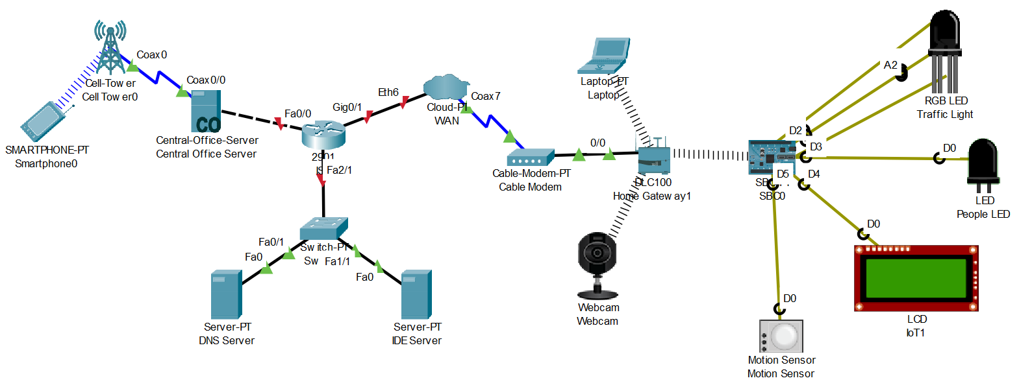
System Architecture
05

Slide 6
Components
1) Microcontroller (MCU-PT)
2) Motion Detector (Motion Detector-PT)
3) LEDs (Red, Yellow, Green)
4) Wireless Router (PT)
5) PC-PT (Personal Computer)
6) Server-PT
7) Copper Straight-Through Cable
8) Wireless Connection
06

Slide 7
Working Principle
Sensors detect vehicle presence, count, and flow rate at intersections.
Data sent to processing unit via network.
System calculates optimal light duration based on real-time traffic.
Traffic lights adjust automatically to minimize waiting time.
07

Slide 8
Software
Simulation Platform: Cisco Packet Tracer
Programming: The microcontroller is programmed using a simple control flow algorithm to adjust traffic lights based on vehicle detection data, typically done using Cisco Packet Tracer's scripting tools.
08

Slide 9
Advantages
Real-Time Traffic Management:
Efficiently controls traffic flow by adjusting signals dynamically based on actual vehicle presence, reducing congestion.
Improved Safety:
Traffic signals respond to real-time traffic conditions, enhancing safety by reducing the likelihood of accidents caused by incorrect signal timings.
Cost-Effective:
Using Cisco Packet Tracer for simulation reduces the need for physical infrastructure and expensive traffic management systems, making it an affordable solution for testing and prototyping.
Energy Efficiency:
The system ensures that traffic lights are only active when needed, conserving energy and reducing operational costs.
Scalable:
The system can easily be scaled to accommodate multiple intersections or expanded with additional sensors and IoT devices for more detailed traffic management.
09

Slide 10
Challenges
Limited Real-World Data: Cisco Packet Tracer cannot fully replicate real-world sensor behaviors and environmental variables like weather, road conditions, and traffic patterns.
Hardware Limitations: The simulation relies on the available hardware and components in Cisco Packet Tracer, which may not offer the same fidelity as real-world IoT devices or networks.
Network Dependency: The effectiveness of the system is highly dependent on the network setup. Network failures can lead to the system becoming non-functional, affecting traffic management.
Complexity in Real-Time Adjustments: Advanced real-time traffic control based on more dynamic inputs (e.g., pedestrians, roadblocks, etc.) would require more sophisticated algorithms and IoT systems than those simulated in Cisco Packet Tracer.
10

Slide 11
Future Scope
The future scope includes integrating machine learning for predictive control, expanding to smart city frameworks, using advanced sensors like cameras, and leveraging real-time data analytics for optimized traffic management across multiple cities.
11

Slide 12
Conclusion
The Smart Traffic Light System using IoT improves traffic flow and safety by dynamically adjusting signals based on real-time data. Future advancements like machine learning, smart city integration, and advanced sensors will further enhance traffic management, making cities more efficient and connected.
12

Slide 13
Thank You
13

